Slide 1
Competitive Programming
15 Dec. 2022
Andrei Novikov

Slide 2
Home Task - Revise
Resource: Competitive Programming 3
Theory:
4.4.3 SSSP on Weighted Graph
4.4.4 SSSP on Graph with Negative Weight Cycle
Practice:
UVa 11367 – Full Tank?
UVa 00929 – Number Maze

Slide 3
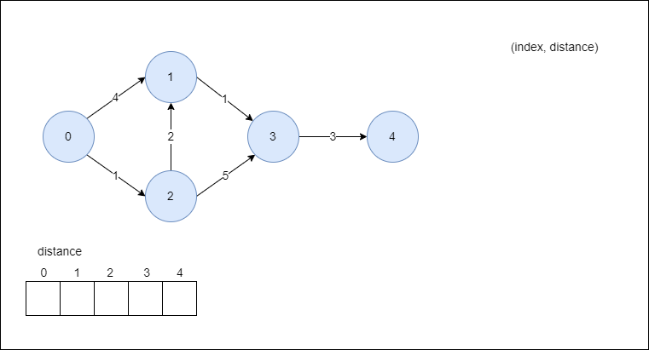
Dijkstra Algorithm (Lazy)

Slide 4
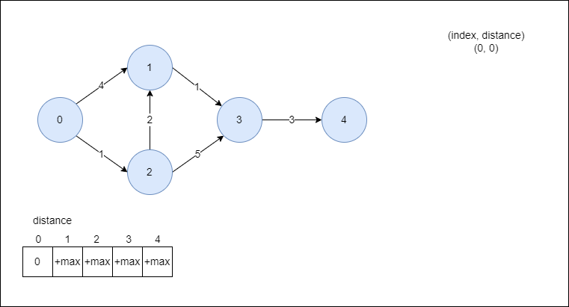
Dijkstra Algorithm (Lazy)

Slide 5
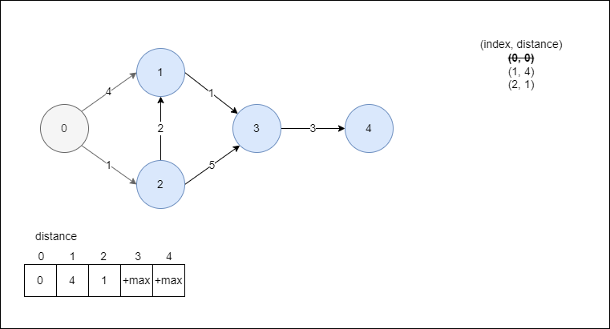
Dijkstra Algorithm (Lazy)

Slide 6
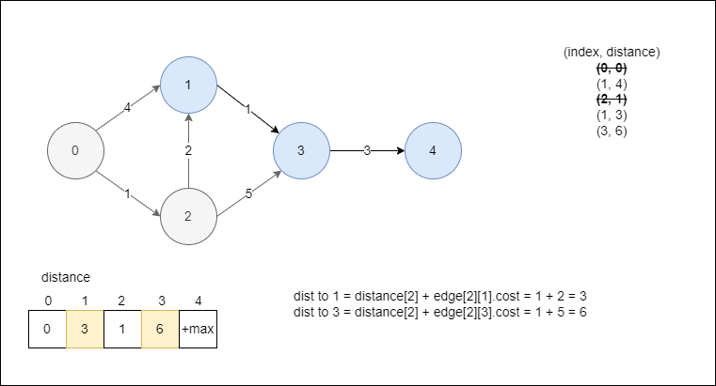
Dijkstra Algorithm (Lazy)

Slide 7
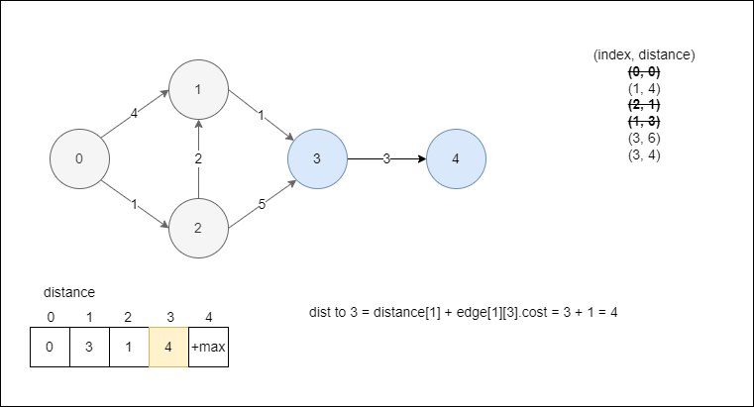
Dijkstra Algorithm (Lazy)

Slide 8
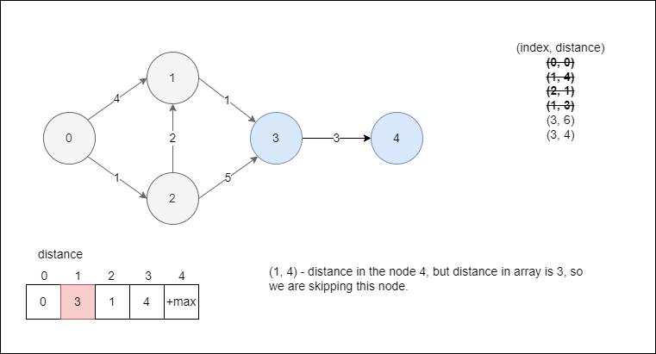
Dijkstra Algorithm (Lazy)

Slide 9
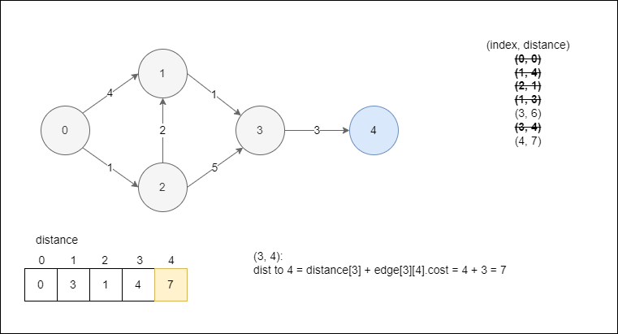
Dijkstra Algorithm (Lazy)

Slide 10
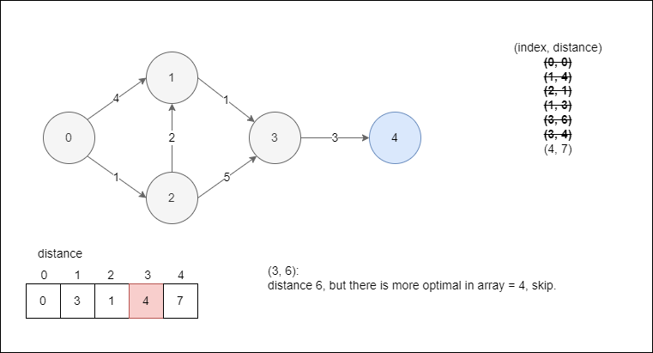
Dijkstra Algorithm (Lazy)

Slide 11
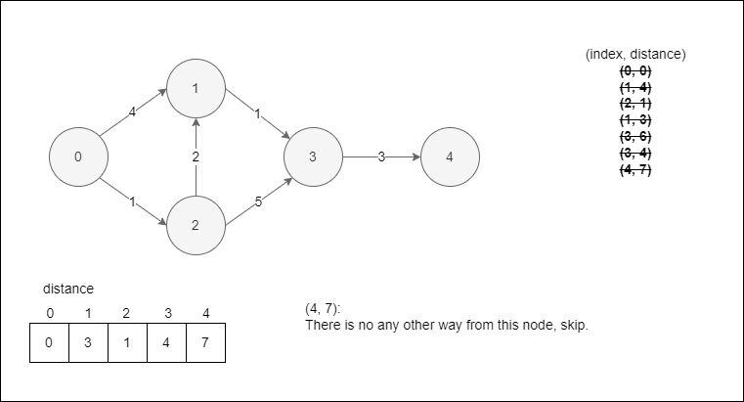
Dijkstra Algorithm (Lazy)

Slide 12
UVa 11367 – Full Tank?
UVa 11367 – Full Tank?
PDF of the task – Link to PDF

Slide 13
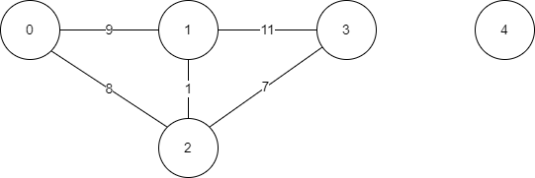
UVa 11367 – Full Tank?
Example of the graph for the task
10$
10$
12$
13$
Additional restriction is capacity of the car
20$

Slide 14
UVa 11367 – Full Tank?
Graph illustration
10$
10$
12$
13$
Additional problem! How much fuel we need to buy at every city to find the cheapest price?
20$

Slide 15
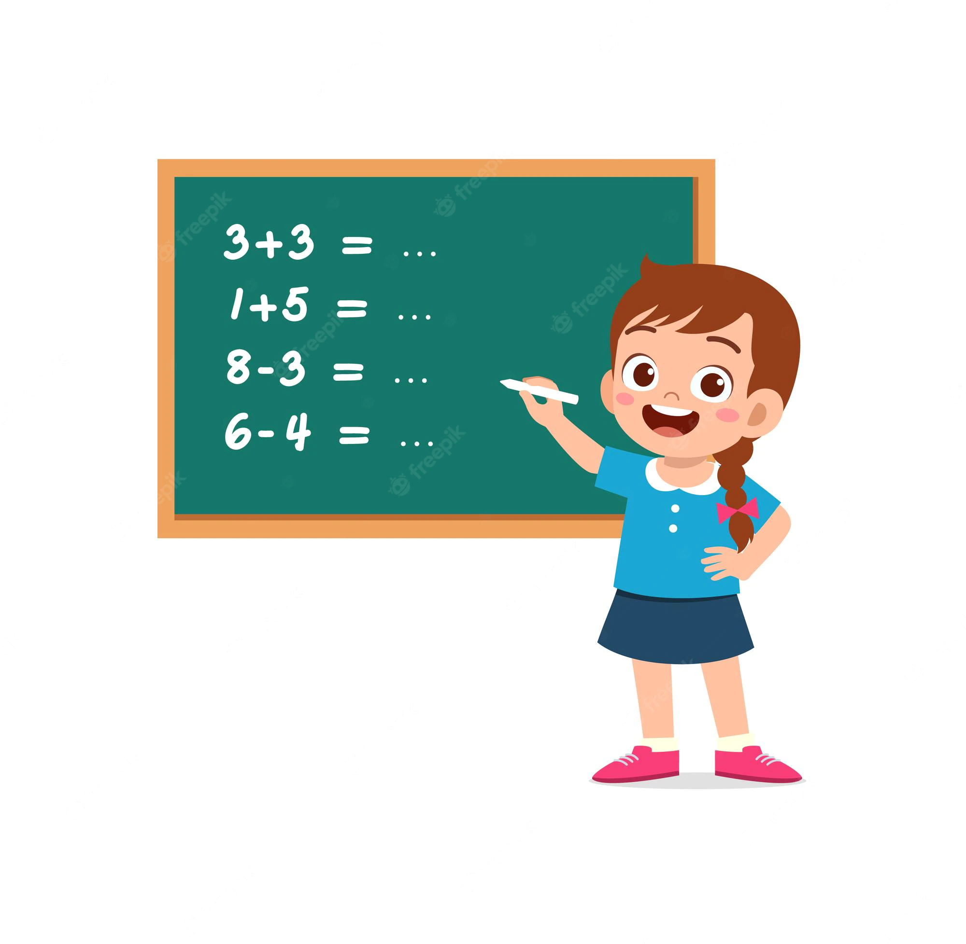
UVa 11367 – Full Tank?
Graph transformation is required.
For every node:
Add node with initial fuel node.fuel + 1 to the queue.
Skip node where the amount of initial fuel is not enough to go to neighbor.

Slide 16
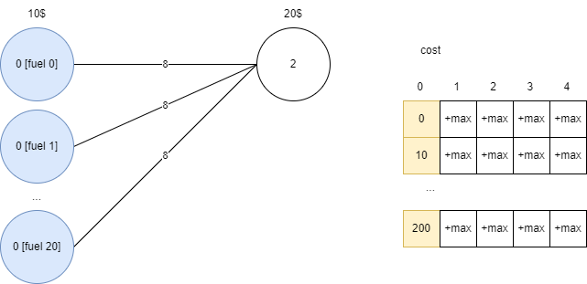
UVa 11367 – Full Tank?
We need to extend our graph by adding new nodes where the amount of fuel that we can buy at ‘from’ city.

Slide 17
UVa 11367 – Full Tank?
Implement the solution.

Slide 18
UVa 11367 – Full Tank?
UVa 11367 – Full Tank?
PDF of the task – Link to PDF
Solution – Link to C++ Solution

Slide 19

Homework
Competitive Programming 3
Just practice on various problem from the covered chapters.
Advent of Code 2022 (or any other year)
If you have time and desire you can practice simpler task, keep your mind warm.

Slide 20




Where to Practice
LeetCode [link]
HackerRank [link]
Kattis [link]
TopCoder [link]
Other Resources

